Slide 1


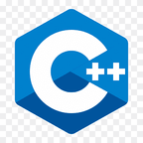
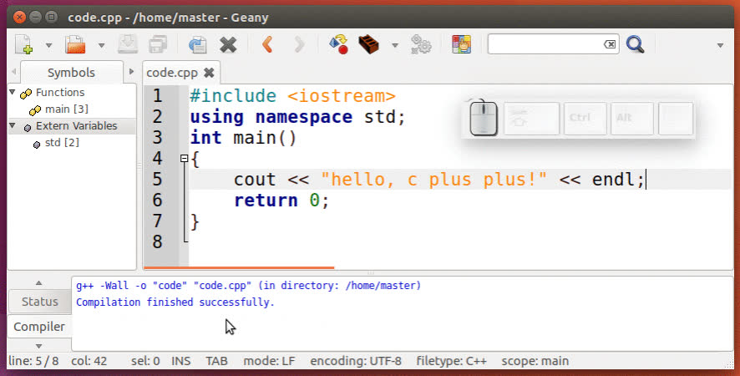

O
VITBhopal University
BJECT
RIENTED
P
ROGRAMMING
Faculty-Prof. (Dr.) Nitin Kumar Mishra
Winter Semester - 2023-24
CSE2001
A11+A12+A13
Anay Verma 22BCE10120
Harshit Vyas 22BCE11412
Shagun Patidar 23MIM10128
Rashi Arora 23MIM10185
WITH

Slide 2
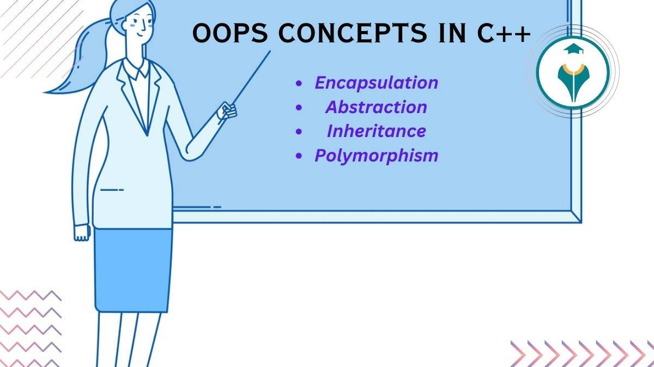

OOP-ERVIEW
Introduction
Concepts
Problem
Algorithm
Code
Output
Conclusion

Slide 3
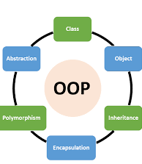
OBJECT ORIENTED PROGRAMMING
Object-oriented programming (OOP) is a programming paradigm that uses objects, which are instances of classes, for organizing code. In OOP, the fundamental building blocks are objects, and these objects can encapsulate data (attributes) and behavior (methods).
Main Principle of listed below:-
Class:
Object:
Encapsulation:
Inheritance:
Polymorphism:
Abstraction:

Slide 4
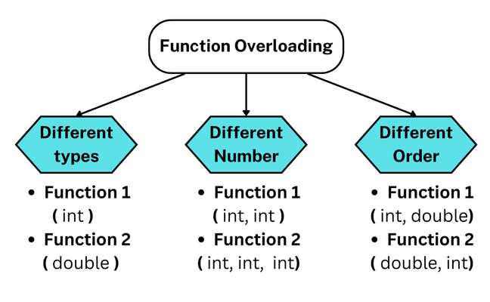
VITBhopal University
CONCEPTS
CLASS - OBJECT
A class is a blueprint for creating objects, defining their attributes and methods, enabling efficient and modular code organization.
An object is a real-world entity that bundles data and behavior, created from a class, promoting modular code organization and abstraction.
FUNCTION
A function is a named block of code that performs a specific task or operation, promoting code organization, reusability, and abstraction.
FUNCTION OVERLOADING
Creation of multiple functions sharing the same name but possessing distinct parameter, fostering polymorphism, enhancing code conciseness and expressiveness.

Slide 5
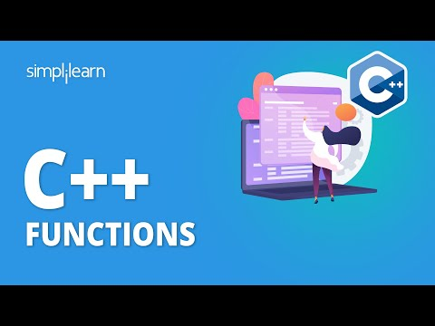
VITBhopal University
PROBLEM
TASK
Write a function named lineChar() that prints a line of characters with two default arguments:
the character and
the length of the line in terms of the number of characters
The first and second arguments take ‘#’ and 40 as the default values, respectively.
Write a main function that calls lineChar three times with zero, one, and two
arguments.

Slide 6
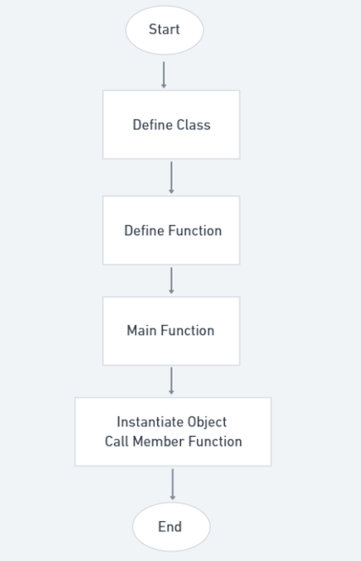
VITBhopal University
ALGORITHM
STEPS
Define the Function: We will declare the lineChar() function is a member function of the class
Set Default Arguments in the Function Declaration: We'll set the default arguments directly in the function declaration inside the class.
Call the Member Function: In the main() function, we'll create an object of the class and call the lineChar() member function on that object.

Slide 7



PROGRAM
CODE
SOLUTION
OUTPUT

Slide 8
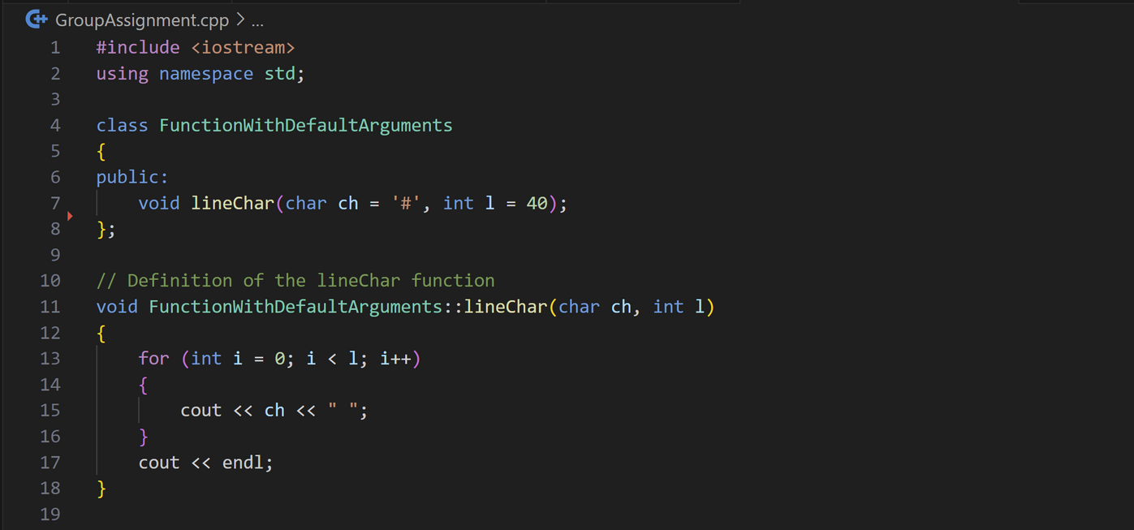
VITBhopal University
CODE

Slide 9
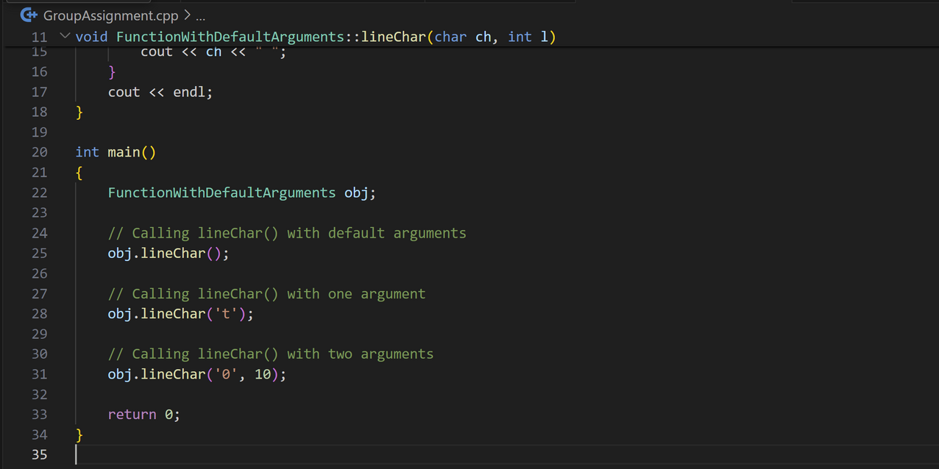
VITBhopal University
CODE

Slide 10
VITBhopal University
EXPLANATION
Setup
It includes tools for printing (iostream) and creates a class named FunctionWithDefaultArguments.
Inside the class, a function named lineChar is defined to handle printing. This function can take a character to print (defaults to '#') and the line length (defaults to 40).
Execution
The main function starts and creates an object of the class. It then calls the lineChar function on this object three times
First, with no arguments, using the defaults (#, 40) to print 40 hash symbols.
Second, with one argument ('t'), keeping the default length (40) to print 40 't' characters.
Third, with both arguments ('0', 10), changing the character to '0' and length to 10, printing 10 '0' characters.

Slide 11
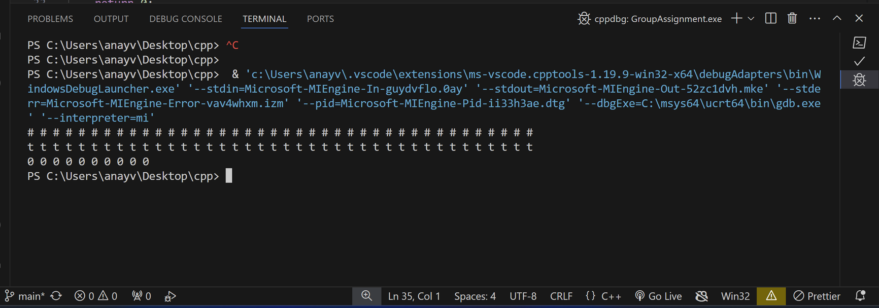
VITBhopal University
OUTPUT

Slide 12





CONCLUSION
This code effectively demonstrates the use of default arguments in C++. It creates a reusable class for printing lines of characters, offering flexibility through defaults and the ability to customize the character and line length during function calls. This approach promotes code conciseness and reduces the need for multiple functions with slightly different functionalities.

Slide 13
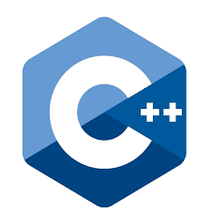
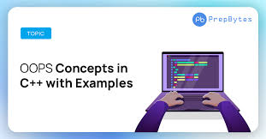

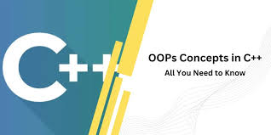

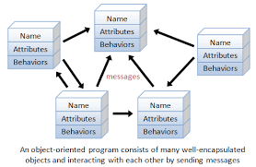

Thank's For Listening
VITBhopal University
Anay Verma
22BCE10120
Harshit Vyas
22BCE11412
Shagun Patidar
23MIM10128
Rashi Arora
23MIM10185

